Slide 1
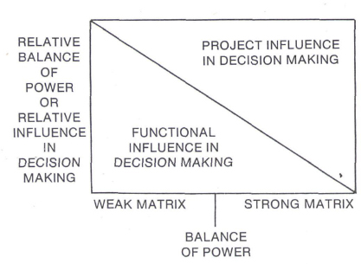

Slide 2
Grant Writing Strategy
External inputs
Executive Director
Strategic Director
Finance Director
CSH
Source Grants
Develop ideas
Connectivity
Connect
NGOs
Resources
Direct missions
Organize pitch and consolidation meetings
Develop ideas
Write grants
Consolidate strategy
Develop budgets
Direct financial scope
Manage reporting
Ground ideas
External NGO
Source Grants
Develop ideas
Connectivity
Donor Initiatives
Grant Coordinator/Manager
Political Initiatives
Lead Project Manager
Lead Program Manager
Sourcing Grants
Organize Meetings
Consolidate Grants
Manage Tracker

Slide 3
Grant Writing KPI
Grant Size | Yearly KPI | Size KPI | Probable Yearly | Net Applications
Small | 12 | $45,000.00 | $756,000.00 | $5,040,000.00
Medium | 4 | $150,000.00
Large | 4 | $475,000.00
Million | 2 | $1,000,000.00

Slide 4
Organizational Structure Future
Grant Coordinator/Manager
Project Managers
Program Managers
Informs work of project – program managers to ensure vision is kept.
Managing day to day for grants that have been won.
Lead project manager interacts with Directors
Projectized Work
Managing meetings, organizations, and organizational pieces.
Lead program manager interacts with Directors
Internship Program Manager

Slide 5
Organizational Structure Future
Executive Director
Financial Director
Strategic Director
Digital Director
Weaker matrix functionality most of the time
Stronger matrix functionality with role specific tasks.
Weaker matrix functionality most of the time.
Stronger matrix for role specific tasks.
Weaker matrix functionality most of the time.
Stronger matrix for role specific tasks.
Senior Project Manager
Senior Program Manager

